Slide 1
Assessment Jargon
The who, what, where, why, when, and how of writing end-of-the-year reports
Sarah Todd
Director of Institutional Research and Assessment
Presentation to School of Business and Liberal Arts
August 24, 2012
todds@canton.edu

Slide 2
What is Assessment?
The systematic collection, review, and use of information undertaken for the purpose of improving outcomes (e.g., student learning and development)
Translation: Determining if what we are doing is working, and making changes for improvement, determining if those changes are working, and making further changes for improvement, and making more changes for improvement, and…
  Systematic: organized and planned
  Review: Appraise critically, evaluate, a formal examination; practice intended to polish performance or refresh memory
  Use: Take or consume
Assessment is not an event, it is a constant process

Slide 3
Assessment vs. Evaluation
 | Assessment | Evaluation
Timing | Formative: Ongoing to foster improvement | Summative: Final to gauge quality/performance
What is it measuring? | Process-oriented: How is it going? | Product-oriented: What’s been accomplished?
Relationship between administrator and recipient | Reflective: Based on internally defined goals and criteria | Prescriptive: Externally imposed standards
Use of findings | Diagnostic: Identify areas of strength and weakness | Judgmental: Arrive at an overall grade/score
Standards of measurement | Flexible: Adjustable as challenges change | Fixed: Designed to reward success and punish failure

Slide 4
Cohort
A group of people sharing a specific characteristic:
  Age
  Student type
  Residential/non-residential
  CSTEP, EOP
  Program of study
  First generation
  Pell eligible

Slide 5

Baseline
The standard by which things are measured or compared
The “starting line”
  Census date
  Previous report date
  Dictated by a higher power

Slide 6
Benchmarks
A description or example of performance that serves as a standard of comparison for evaluation or judging quality
Translation: A standard by which something can be measured or judged
Types of benchmarks:
  Peers (aspirational and reality)
  Where we are now (baseline)
  Where we want to be
  Where others say we should be

Slide 7
Goals vs. Objective
Goal: A general description of the wider problem your project with address, offering a reason why the task will be performed
  Objective: More detailed than a goal, includes the who, what, where, why, when, and how
  Specific: to the problem you are addressing
  Measureable: changes must be quantifiable, be numeric to address issues of quantity and quality
  Appropriate/attainable: to the goals and the environment; must be feasible and within your control/influence
  Realistic: Measures outputs/results – not activities
  Times: Identifies target date for completion of objectives and includes interim steps and a monitoring plan

Slide 8
Objectives
MEASUREABLE
Used to express intended results in precise terms
Specific as to what needs to be assessed and help guide the appropriate assessment tool

Slide 9
Outcomes
Observable (documentable!) behaviors or actions that demonstrate that the objective has occurred
Your objectives carried over

Slide 10
Measures of Student Learning
Direct: Student learners display knowledge and skills as they respond directly to the instrument itself.
  Objective tests
  Essays
  Presentations
  Classroom assignments
Indirect: Student learners reflect on their learning rather than demonstrating it.
  Surveys (exit, current and graduating students, alumni, employer, etc.)
  Interviews
  Focus groups

Slide 11
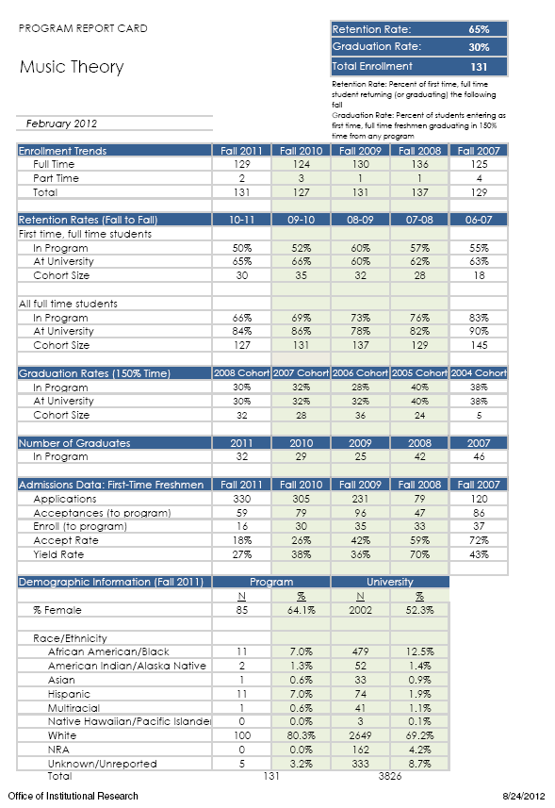
Using Your Program
Report Card
The goals and objectives you insert in your program scorecard depend entirely on the specific goals and direction of your program
The report card can assist you in framing goals and objectives on enrollment, retention rates, graduation rates, admissions, number of graduates and diversity
In the next installment, enrollments by student type, average GPA, survey results will be incorporated

Slide 12
Using Your Program
Report Card
Follow a cohort of students through the report card
The Fall 2008 cohort size and retention rates can assist in predicting the graduation rates
The yield rate and enrollment rate can assist in predicting these as well

Slide 13
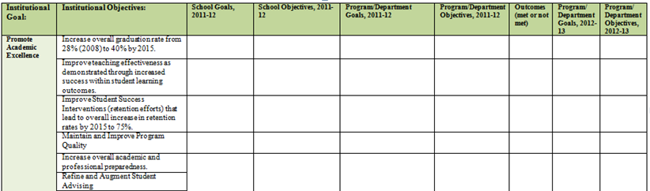
Putting It Into Your Scorecard
Program is currently at a 32% graduation rate.
Institutional goal is 40%
Set a program goals based on the reality of where you are, the interventions/changes you intend to make, and the direction you need to be heading
The yield rate and enrollment rate can assist in predicting these as well

Slide 14
Trying it all out
Let’s perform an assessment of my presentation, focusing on wardrobe:
  What is the cohort?
  What is the baseline?
  What benchmarks are we going to use?
  What are the goals?
  What are the objectives?
  What are some direct and indirect
  measures of student learning?
  What are the outcomes?

