Slide 1


Billing Instructions
Understanding Your
Student Account Bill

Slide 2

Are you having trouble completing or understanding the Billing Process?
The Billing Process for your stay at SUNY Canton may be hard to understand. In the following slides, you will find a step-by-step guide on how to complete your bill in order to start and/or continue your stay at SUNY Canton!

Slide 3
INDEX
Logging into UCanWeb
Finding the Billing Menu
Finding and Completing the Surveys
Health insurance waiver
Accepting Awards
Completing the Financial Aid Disbursement Authorization page
Reviewing your bill
Paying Online
Numbers for help
4
8
9
16
19
20
24
27
30

Slide 4
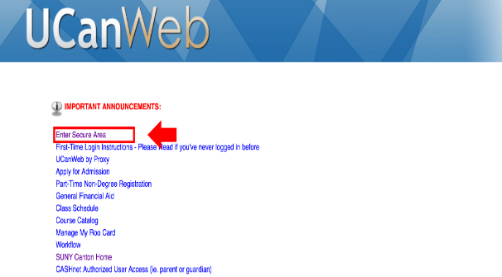
Step 1: Go to UCanWeb
INDEX
From the SUNY Canton homepage at http://www.canton.edu, under the ‘Students’ menu at the top of the webpage then select the UCanWeb link at the bottom of list
~OR~
From the ‘Quick Links’ dropdown menu and select the ‘UCanWeb’ option at the bottom of the list.
~OR~
Click this link UCanWeb

Slide 5
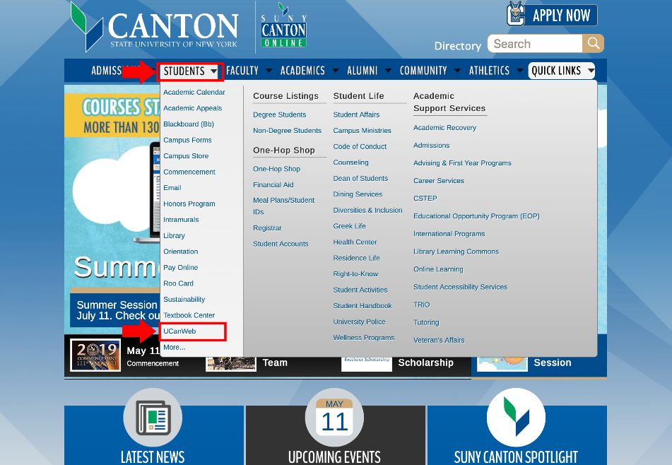
INDEX

Slide 6
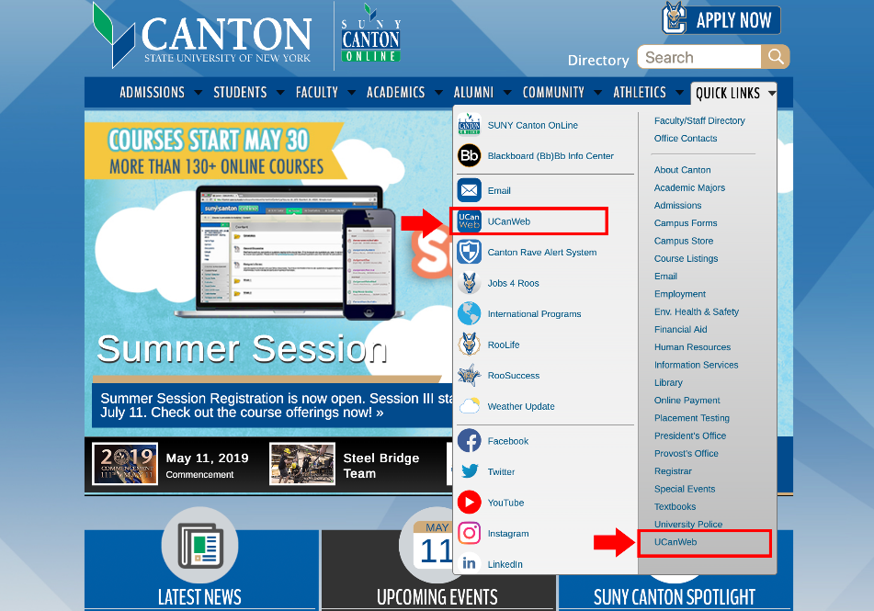
INDEX

Slide 7
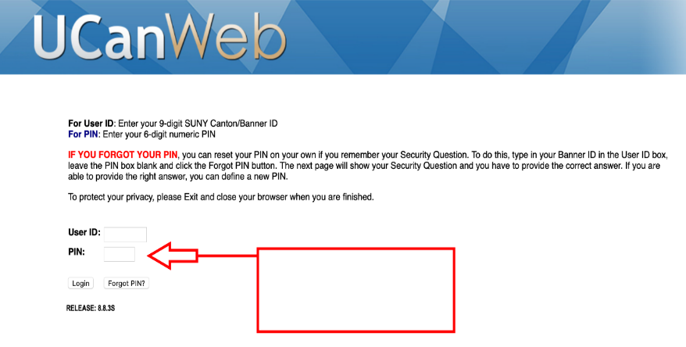
Step 2: Log Into your UCanWeb account
INDEX
Use your nine-digit Student I.D. Number (begins with 805-, 804- or 803-) as User ID. Your PIN will be two digits of your birth month, two digits of your birth day, and
the last two digits of your birth year.
PIN Examples are:
010291 (if born January 2, 1991)
121800 (if born December 18, 2000)
**If you have difficulty logging in, call the Registrar’s office at
(315)386-7616.

Slide 8
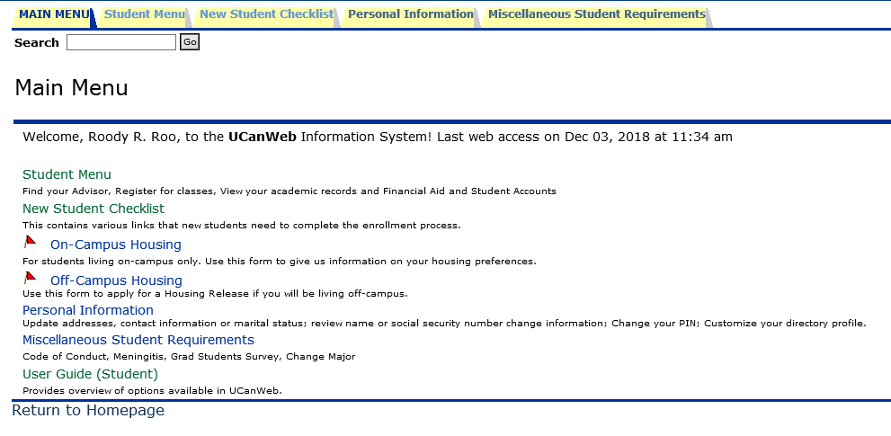
Step 3: Select Student Menu
INDEX

Slide 9
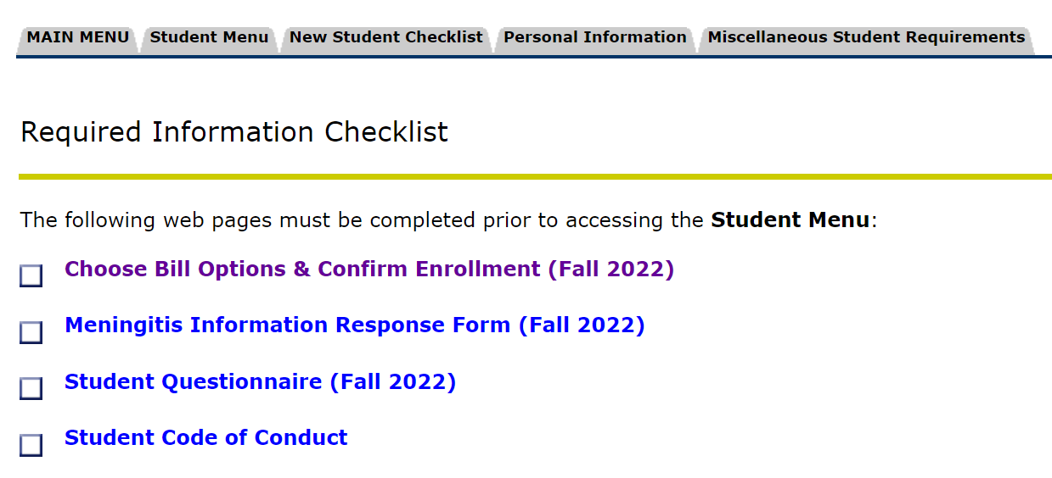
Step 4: Complete the Billing Survey
INDEX
{This page will pop up if surveys are not complete.}
Click on: Choose Bill Options & Confirm Enrollment

Slide 10
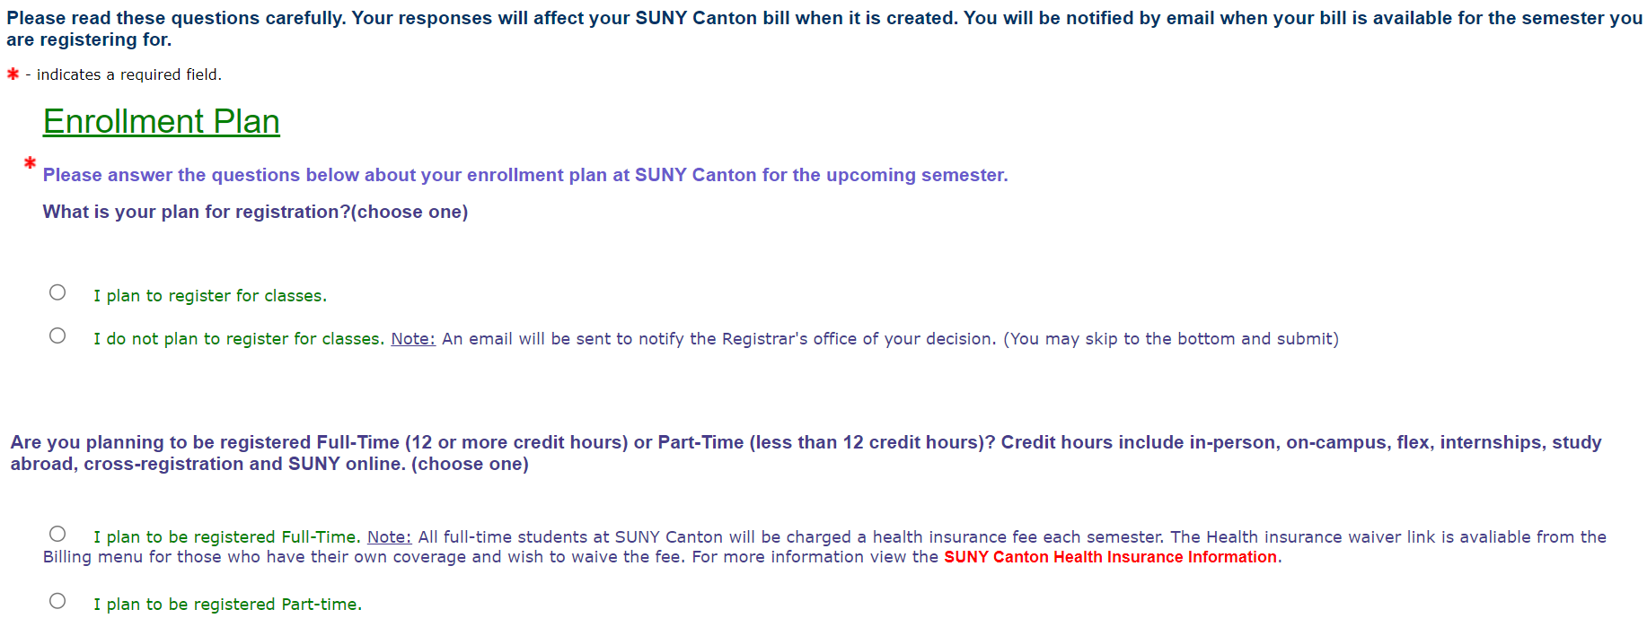
INDEX
Answer the survey questions according to your student status.

Slide 11
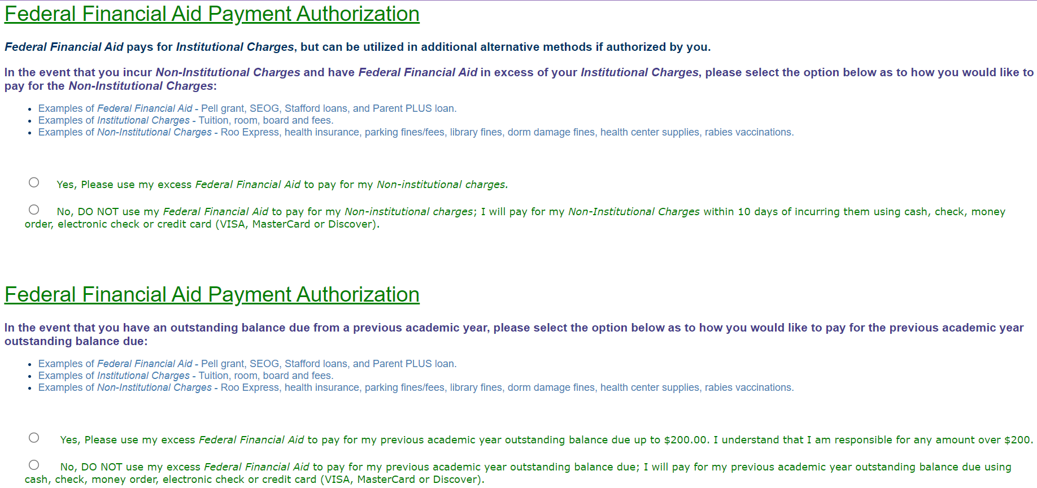
INDEX
Answer the survey questions to authorize use of financial aid.

Slide 12
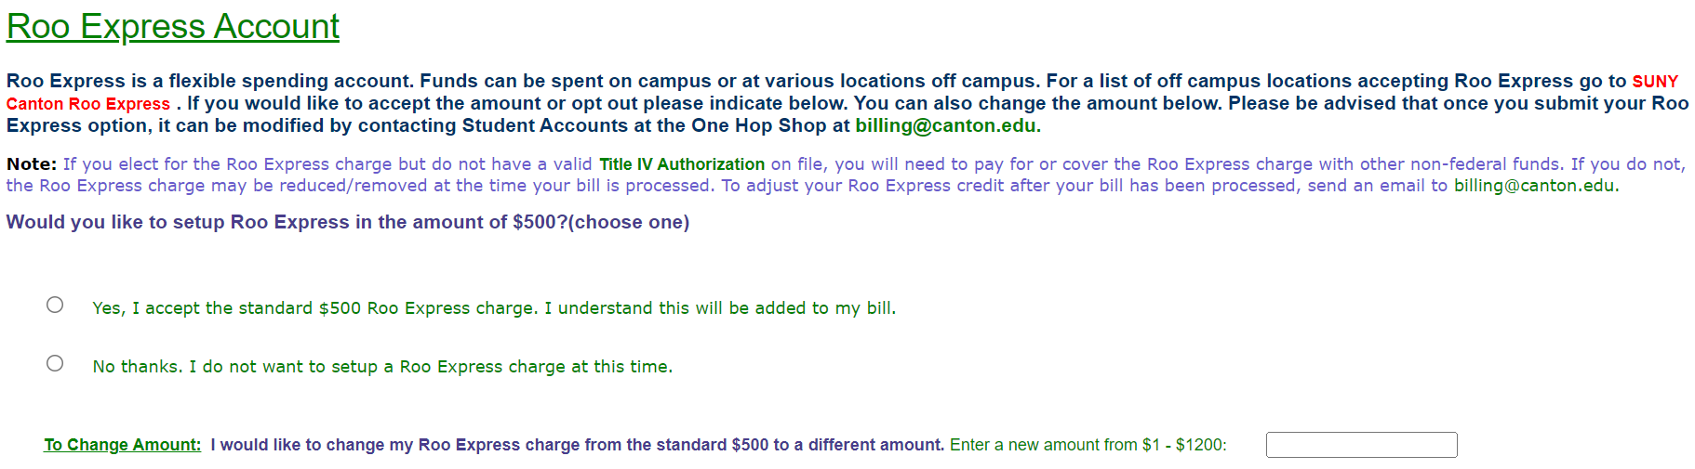
INDEX
Answer the Roo Express question.

Slide 13
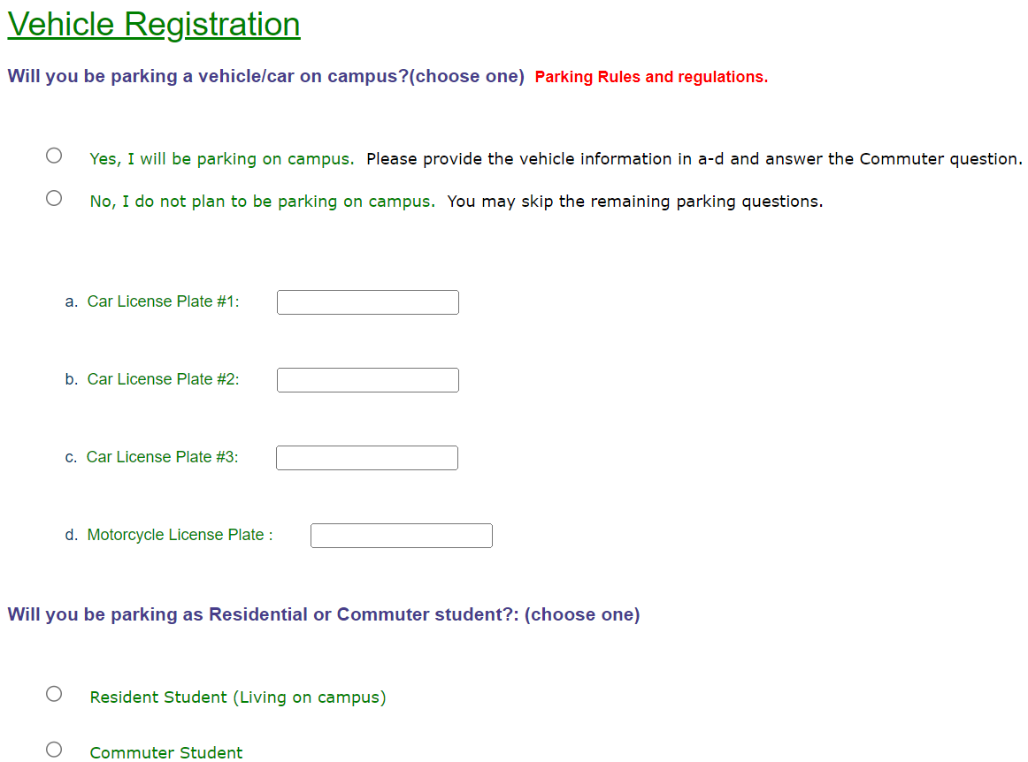
INDEX
Answer the parking questions.

Slide 14
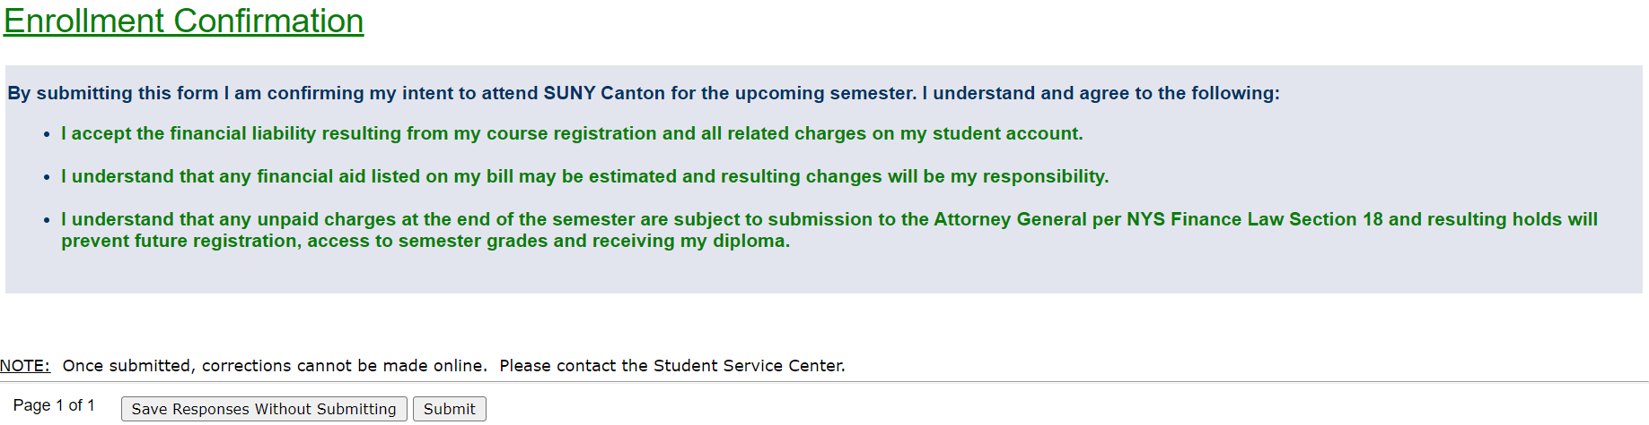
INDEX
Submit the survey responses.
** If you need to change an answer on the survey email billing@canton.edu

Slide 15
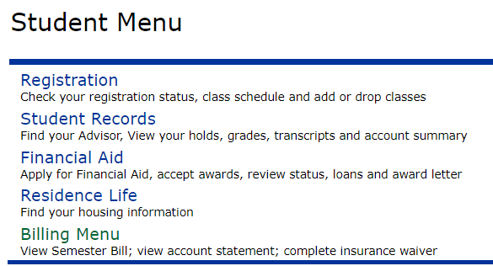
Step 5: Select Billing Menu
INDEX

Slide 16
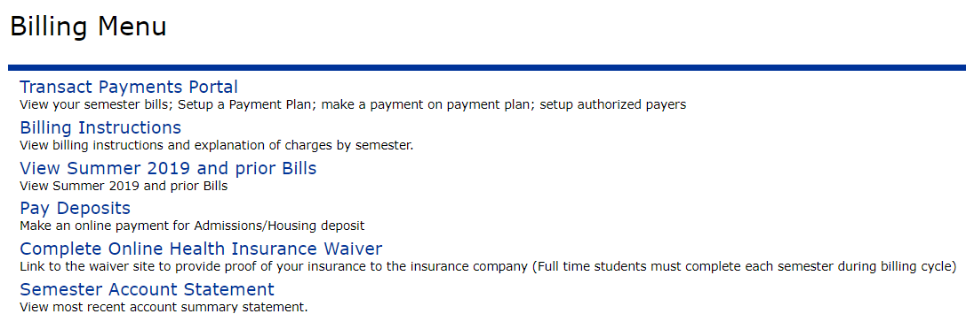
Step 6: Waive Health Insurance
INDEX
Click on: Complete Online Health Insurance Waiver
Fill out the information according to the medical insurance you are covered under.
In order to waive your insurance:
You MUST have your own valid insurance information, as it will be confirmed.
You MUST waive before the deadline!

Slide 17
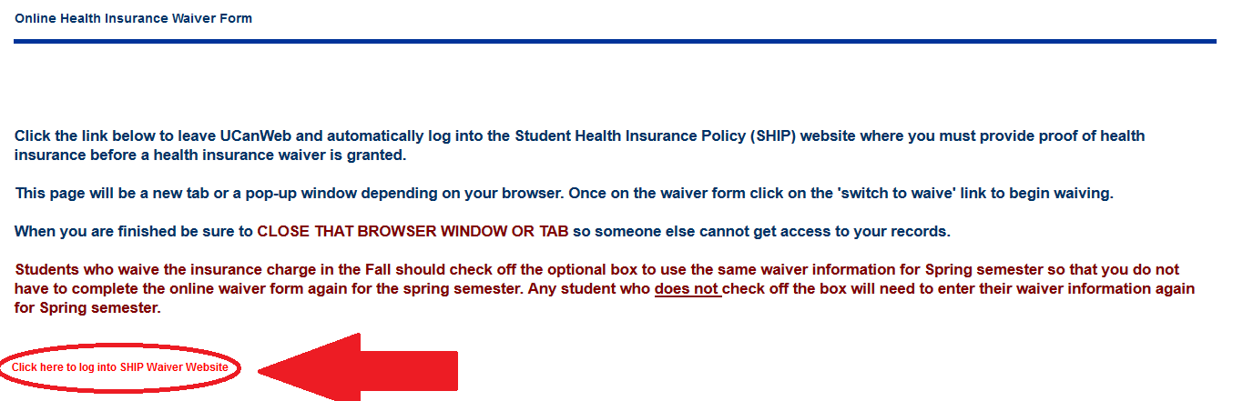
INDEX
On this page, click the small red link at the bottom of the text. This will send you to another website where you will have your insurance information in order to fill it out completely. If you have trouble with this step, you can call (866)535-0456 for help.

Slide 18
Health Insurance Portal
INDEX
Click the “Switch to Waive” button next to your ‘Record Type’ row.
Fill out the information according to the medical insurance you are covered under.
You will receive an email confirming that the waiver was approved.
If you have trouble, you can call the SUNY Canton medical insurance company at (866)535-0456, or Student Accounts at (315) 386-7616 or (800) 388-7123.

Slide 19
Step 7: Accepting Awards
INDEX
Awards are any type of financial aid that will help you with your tuition and other bills. When accepting these, you obtain money to help you pay for either incurrence.
Complete these tabs IN ORDER:
General Information
Terms & Conditions
Accept Award Offer

Slide 20
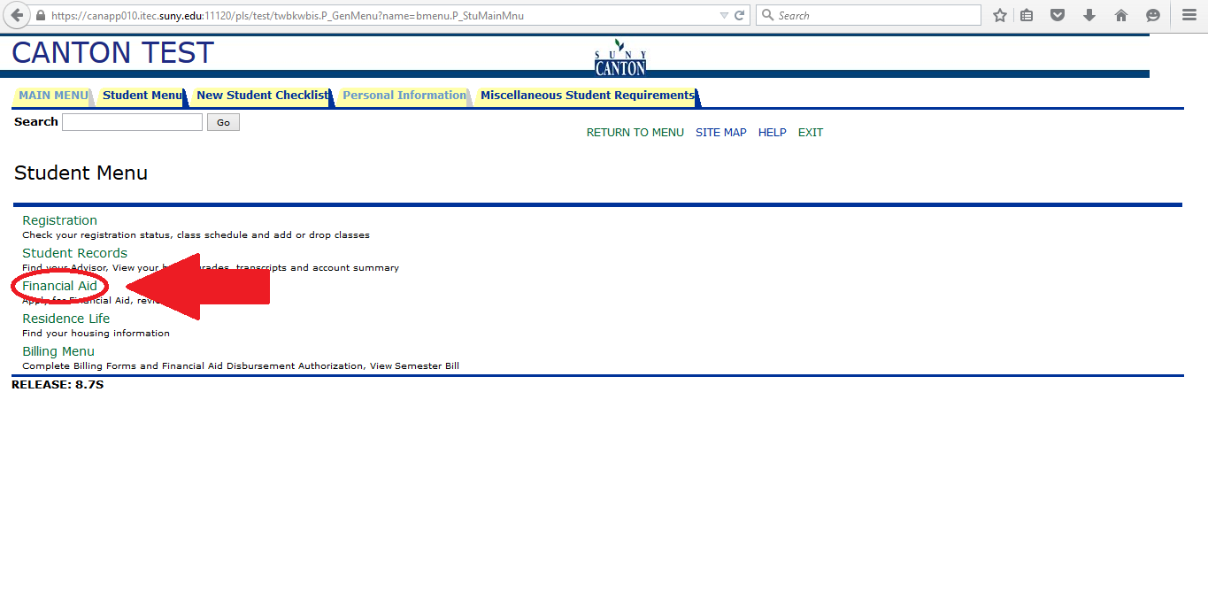
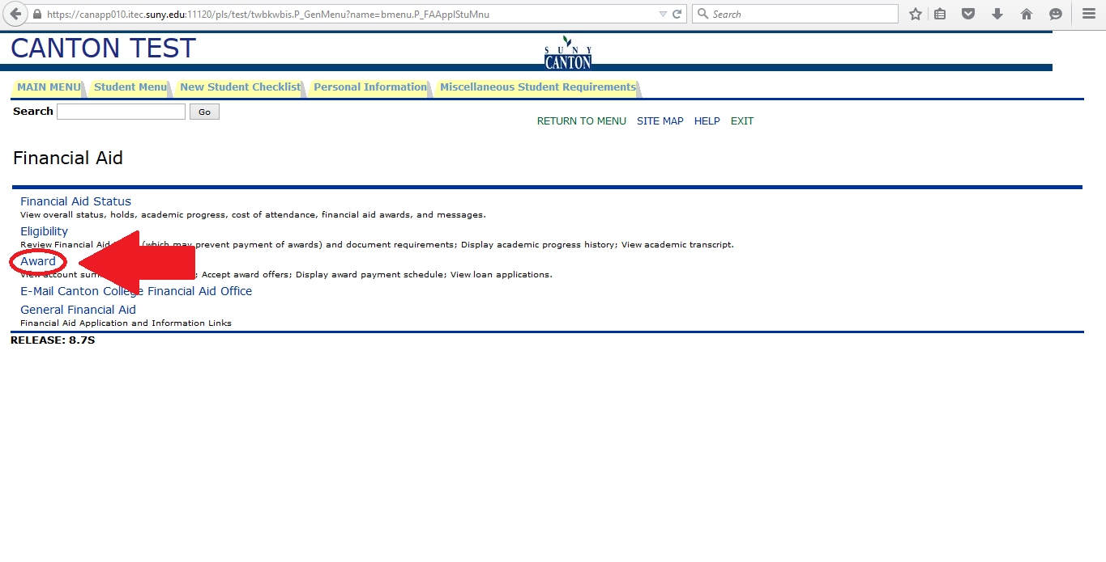
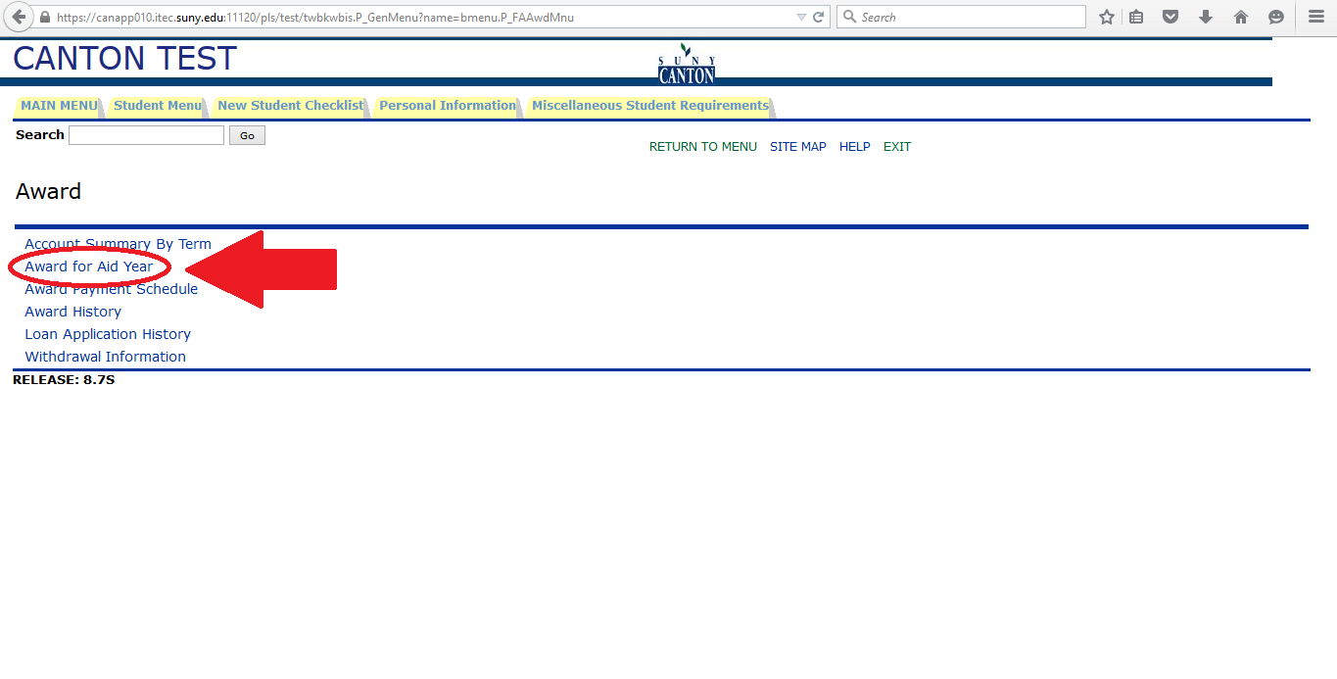
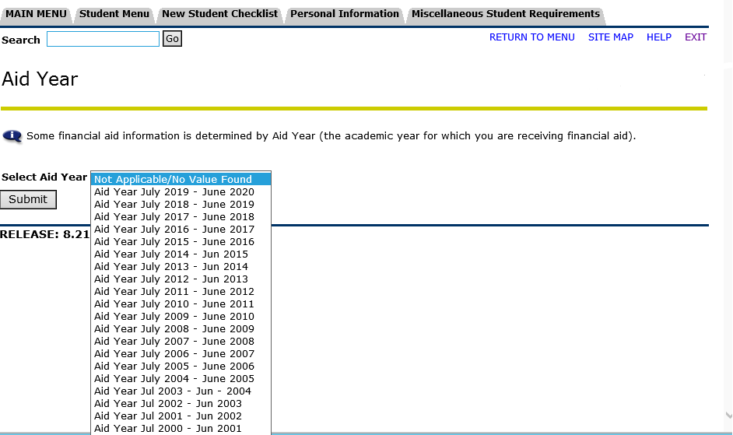
INDEX
On the next screen, click ‘Financial Aid’.
Then, click ‘Award for Aid Year, then select the aid year.
Next, click ‘Award’.

Slide 21
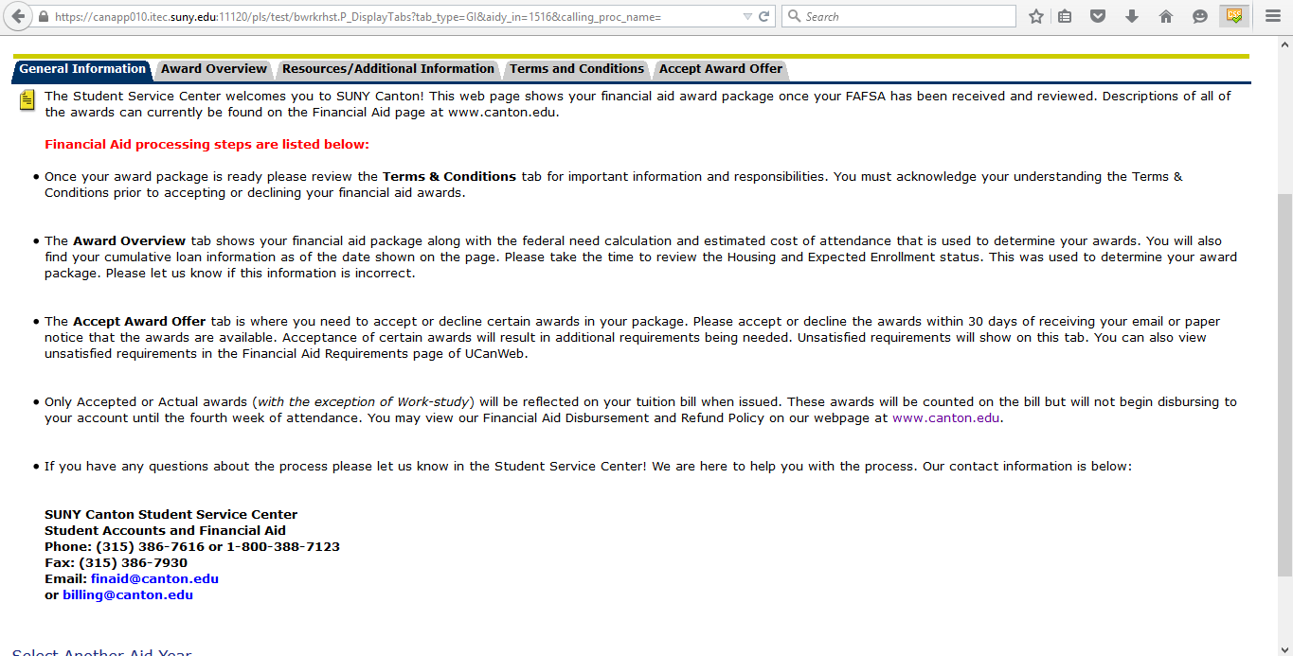
INDEX
On the ‘General Information’ tab, you get an overall simple view of the steps of Financial Aid processing and what happens when you accept your awards.

Slide 22
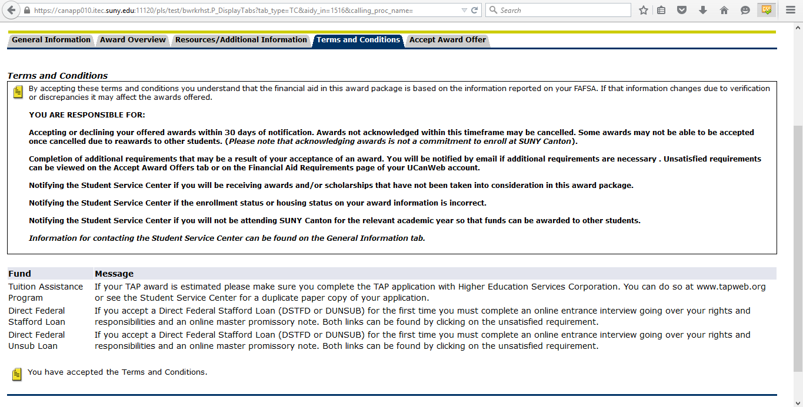
INDEX
On the ‘Terms & Conditions’ tab, there will be an option at the bottom of the page to click to accept the Terms & Conditions of accepting your awards. You have to complete this step to accept any awards.

Slide 23
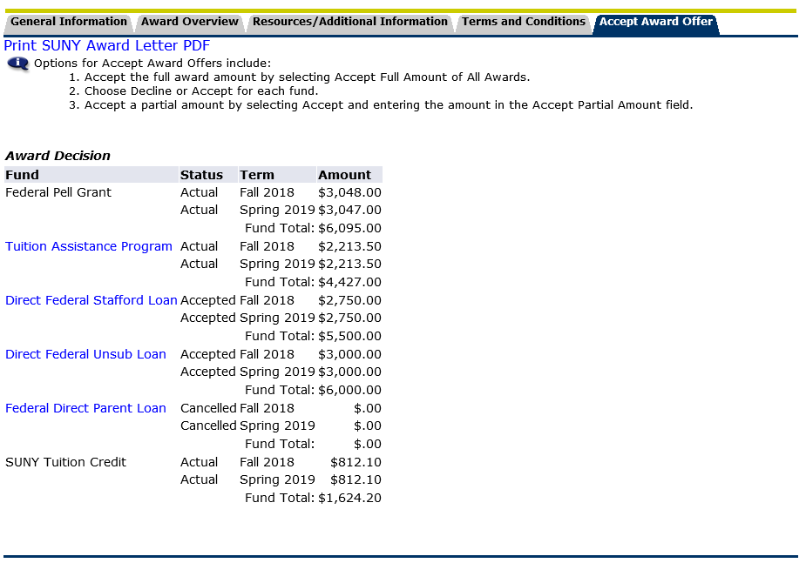
On the ‘Accept Award Offer’ tab, you are given the option to accept all awards, accept parts of awards, or decline awards. Depending on your need or preferences, it is up to you on how much of each award you wish to accept.
INDEX
***NOTE: The accepting or declination of an award will be reflected under the ‘Status’ column under ‘Award Decision’. The ‘Actual’ status means the actual amount granted.

Slide 24
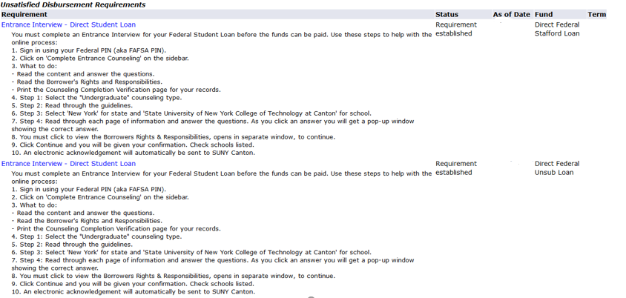
INDEX
While still under the ‘Accept Award Offer’ tab, scroll down. You will see a list titled ‘Unsatisfied Disbursement Requirements’. These are any requirements that have not been met by you as of you viewing of your bill. You must finish these in order to be disbursed your awards.
The blue links that are the title of the Unsatisfied Disbursement Requirements are the links that take you to the page(s) you need to fill out. These links are provided for your convenience.

Slide 25
Step 8: Review Your Semester Bill
INDEX
Click on: Transact Payments Portal to review your bills, make a payment, or set up an Authorized Payer

Slide 26
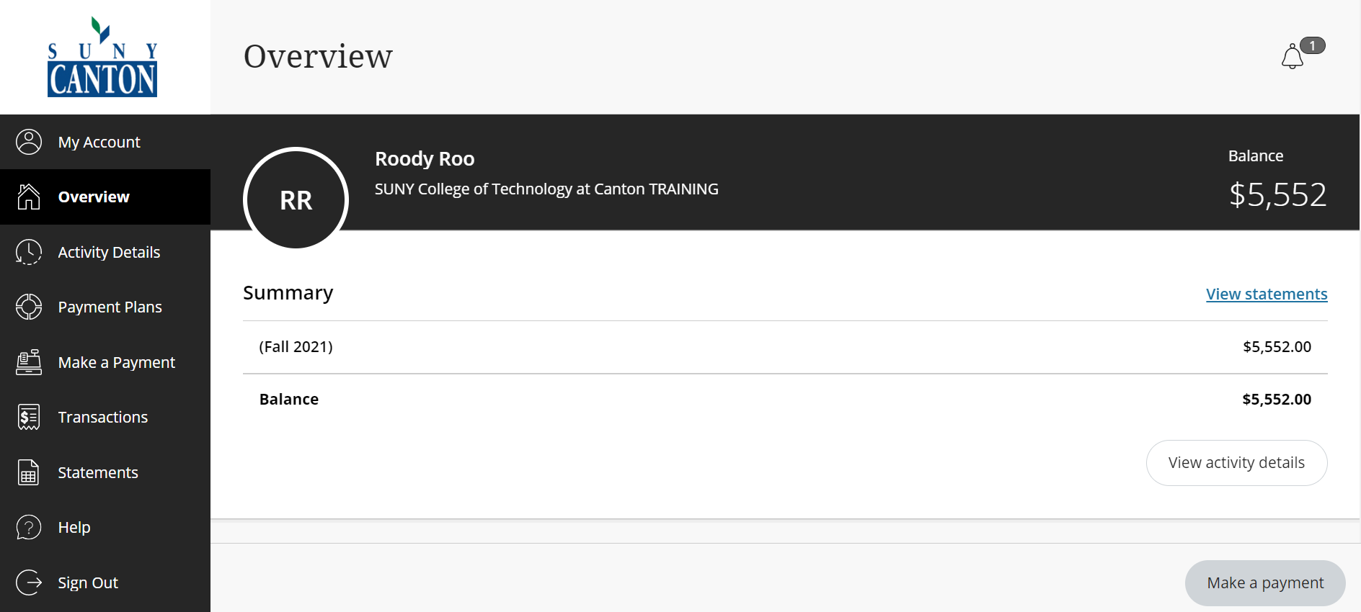
Transact Payments Portal
INDEX

Slide 27
Transact Payment Options
INDEX
Students can pay their bill on-line through their UCanWeb account in the
Transact Payments portal:
Click Make a Payment to pay by Credit/Debit Card or Checking Account
  Fill in the ‘Amount Due’ from the most current ‘Statement’ TOTAL DUE column
  Select ‘Checkout’ to finish the transaction
Click Payment Plans then “view payment plan options”
    This window will break down your total due into 5 or 4 monthly installments and will include enrollment fee. (The number of monthly installments is determined automatically based on the enrollment date into the payment plan.)
    Fill in the ‘Plan Amount’ from the most current ‘Statement’ TOTAL DUE column
    Click Enroll in Plan

Slide 28
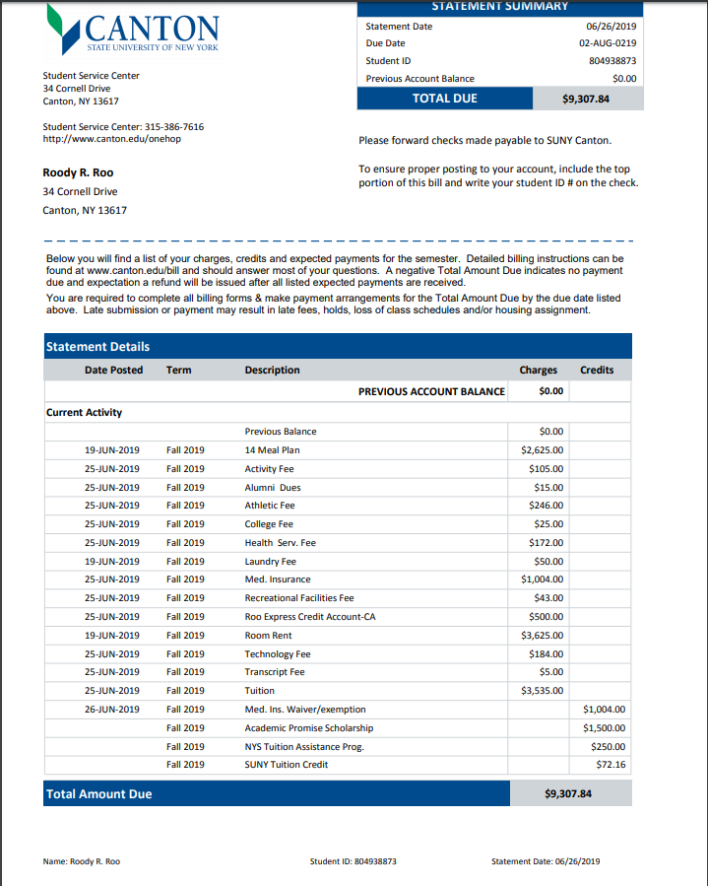
INDEX

Slide 29
Step 9: Watch Your Email
INDEX
An email will be sent to your Canton email:
When your bill has been confirmed and processed (this means that you are officially registered)
- OR –
If you have issues that are delaying the process
Delays happen; no one can predict all reasons your bill may be delayed. For this reason, students should! A notification will be sent to notify you of issues delaying the process.

Slide 30
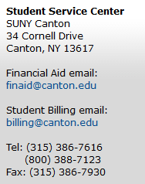
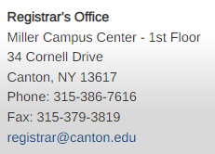
For help on any of the steps, call:
INDEX
Log-in information help
Passcode/password help
Username help
SUNY Canton I.D. # help
Billing help
Financial Aid help
Payment help

Slide 31


Enjoy your stay at SUNY Canton, where great majors lead to great careers!
INDEX

