Slide 1
Funeral Services Administration Program Online Learning Orientation
State University of New York at Canton
Darien B. Cain, Lecturer Date: February 15, 2024

Slide 2
Welcome to the Funeral Services Administration Program at SUNY Canton!
Welcome Future Funeral Service Student.
The Goals for this Online Orientation:
1. Understand the time requirements and program expectations
2. Understand the challenges of Online Learning
3. The Program and Student Learning Outcomes that need to be achieved
4. The support services available for Online learners and finally
5. A brief introduction to student services.

Slide 3
Is the FSAD program an accredited program?
ACCREDITATION:
The Funeral Services Administration program at the State University of New York (SUNY) at Canton, is an accredited program by the American Board of Funeral Service Education (ABFSE), 992 Mantua Pike, Suite 108, Woodbury Heights, NJ 08097; www.abfse.org; (816)233-3747.
National Board Examination pass rates, graduation rates, and employment rates for this and other ABFSE-accredited programs are available at www.abfse.org. To request a printed copy of this program's pass rates, go to the office of the FSAD program Director, Cook 109 or by email at penepentd@canton.edu, or by telephone 315-386-7170.
SUNY Canton is Accredited through the New York State Department of Education and Nationally Accredited by Middle States.

Slide 4
About the FSAD Program
The FSAD program at SUNY Canton is Bachelor of Technology degree in Funeral Services Administration and is open to new students, transfer students and funeral directors who have passed the National Board Examination and are licensed.
122 Credits are required to graduate from the program
Prior Higher Education credits are evaluated. Provide all transcripts to Admissions at the application process.
Modalities of delivery: On-Campus or Online (synchronous or asynchronous)
Asynchronous students are required to watch the class recordings within 24 hours from the scheduled lecture and submit coursework on or before the due dates.

Slide 5
Time Management is the KEY to Online Success
For every 3-hour Online course, the student should plan to spend a minimum of 6 to 9 hours per week, in addition to watching the lectures, reading, studying, doing assignments and taking examinations.
Online students MUST be affiliated with a funeral home to do some FSAD course work.
Don’t over-extend yourself.
Plan when assignments and exams are due dates.
Studying time free from distractions

Slide 6
Class Information
There are set times for all classes. Either attend in real time or watch the recordings.
Asynchronous students must watch the recordings within 24 hours from when they were created.
Contact the instructor for clarification
Punctuality and Due Dates are very important in the FSAD Program
Getting behind in course requirements usually result in poor grades.

Slide 7
Class Participation
Online and On-Campus students will collaborate on some assignments in FSAD 225 Professional Funeral Practice, FSAD 245 Accounting and Technology for Funeral Services and FSAD 322 Funeral Home Management II
Use Proper Netiquette at all times
Be respectful.
Be responsible.
Follow directions.
Be punctual.
Be organized.
Be a self-starter.
Do your own work

Slide 8
Plagiarism
Plagiarism will not be tolerated
Including copying other people’s work;
failure to properly cite (using APA 7 style) sources;
use of Artificial Intelligence (AI) to create papers or assignments;
using work previously submitted in another class without receiving permission from the instructor

Slide 9
Classes that Require Funeral Home Practical Experience
Embalming
Funeral Experience
FSAD 121- Analytical Embalming (synchronous online, asynchronous online) a. Minimum of 5 embalmings in the funeral home are required (for lab portion)
FSAD 211- Embalming and Aseptic Technique (synchronous online, asynchronous online) a. Minimum of 5 embalmings in the funeral home are required (for lab portion)
FSAD 129- Clinical Practicum (all modalities) a. Minimum of 5 embalmings in the funeral home are required b. Minimum of 5 funeral services are required c. Time logs are required
FSAD 440- Internship (all modalities) a. Minimum of 10 embalmings in the funeral home are required b. Minimum of 10 funeral services are required c. Time logs are required d. Students will complete a project in the funeral home e. Students will write an obituary
FSAD 307- Human Response to Death (synchronous online, asynchronous online) a. Students will complete a checklist of tasks under supervision of a funeral director

Slide 10
Do I have to come to Campus?
ALL Online students need to come to campus during their Senior Year when taking FSAD 323 Restorative Art for a four-day weekend.
Weekend: The weekend before semester break begins
Students are responsible for their own lodging and food
At this weekend, the students’ practical knowledge will be assessed in Embalming and Restorative Art. A cadaver will be embalmed, restored, dressed and cosmetized.

Slide 11
Student Learning Outcomes
Each course has specific Student Learning Outcomes that are assessed at the end of the course
Students in the Online cohort are assessed the same as the students who are on-campus
Student seeking licensure as a Funeral Director/Embalmer will be required to take the NBE Exam*:
A. Arts Section (Soft Sciences)
B. Science Section (Hard Sciences)
*Online Students’ First Time Test Taker pass rates are tracked separate from on-campus students for ABFSE annual reporting purposes.

Slide 12
Program Learning Outcomes
Upon completion of the FSAD Program, you will:
1. Explain the importance of funeral service professionals in developing relationships with the families and communities they serve.
2. Identify standards of ethical conduct in funeral service practice.
3. Interpret how federal, state, and local laws apply to funeral service in order to ensure compliance.
4. Apply principles of public health and safety in the handling and preparation of human remains.
5. Demonstrate technical skills in embalming and restorative art that are necessary for the preparation and handling of human remains.
6. Demonstrate skills required for conducting arrangement conferences, visitations, services, and ceremonies.
7. Describe the requirements and procedures for burial, cremation, and other accepted forms of final disposition of human remains.
8. Describe methods to address the grief-related needs of the bereaved.
9. Explain management skills associated with operating a funeral establishment.
10. Demonstrate verbal and written communication skills and research skills needed for funeral service practice.

Slide 13
Computer Equipment Needed
MINIMUM TECHNOLOGY REQUIREMENTS:
• Internet Connection: A broadband connection such as cable or DSL is preferred. Ethernet connections are highly recommended for test taking. *Dial-up and Wi-Fi connections introduce connection interruptions when taking tests in Brightspace. • Operating System: To be able to participate in this online course, your operating system must conform to these Technology Requirements. • Web Browser: For the best possible experience in this online course, we recommend using browsers based on Open SUNY Online Course Browser Compatibility. In addition, use the “Open SUNY Browser Compatibility” module on your Brightspace login page to check system compatibility for every login. • Hardware: Please see the list of required hardware from the list of Technology Requirements. • Additional Software: To be able to fully participate in this course, you are required to use the following software: Microsoft Word, Microsoft PowerPoint (or PowerPoint Viewer), Adobe Acrobat Reader. [*Specific course requirements might differ. Software downloads are available at Technology Requirements

Slide 14
Computer Equipment Needed
Microsoft Teams: Some courses will utilize Microsoft teams. You may sign up for free using your canton login credentials. https://www.microsoft.com/en-us/microsoft-teams/download-app * Students must have a working camera and microphone to communicate with the instructor. Some courses do contain oral exams.
TECHNICAL SUPPORT INFORMATION: • For issues with NetID, passwords, or campus email: Contact the SUNY Canton Help Desk: o Call 1-315-386-7448 o Email: helpdesk@canton.edu o Visit: SUNY Canton Information Services for hours of operation
For issues with Brightspace (BS) Contact the Open SUNY Help Desk: o Call 1-844-673-6786 o Submit a ticket at SUNY Online Support Services o Visit: SUNY Online Support Services Helpdesk for hours of operation * Find more student resources at SUNY Canton Brightspace Info Center
NETIQUETTE: All communications must be within the acceptable netiquette rules: Link to the college’s Computer Use & Network Policy. We will not tolerate policy for bullying, harassment, or hate speech of any kind.

Slide 15
Support Services for Online Services
Accessibility & Accommodated Services
TRIO Services
Online Learning/Technical Support
Scholarship/Financial Aid
Library Resources
For Online Research
For Tutoring Assistance
Tutorials on “How To:”

Slide 16
The Faculty At SUNY Canton
We are here for your success. When you succeed, we succeed. Unlike other Online programs, we expect you to interact with others and engage in the learning process.

Slide 17
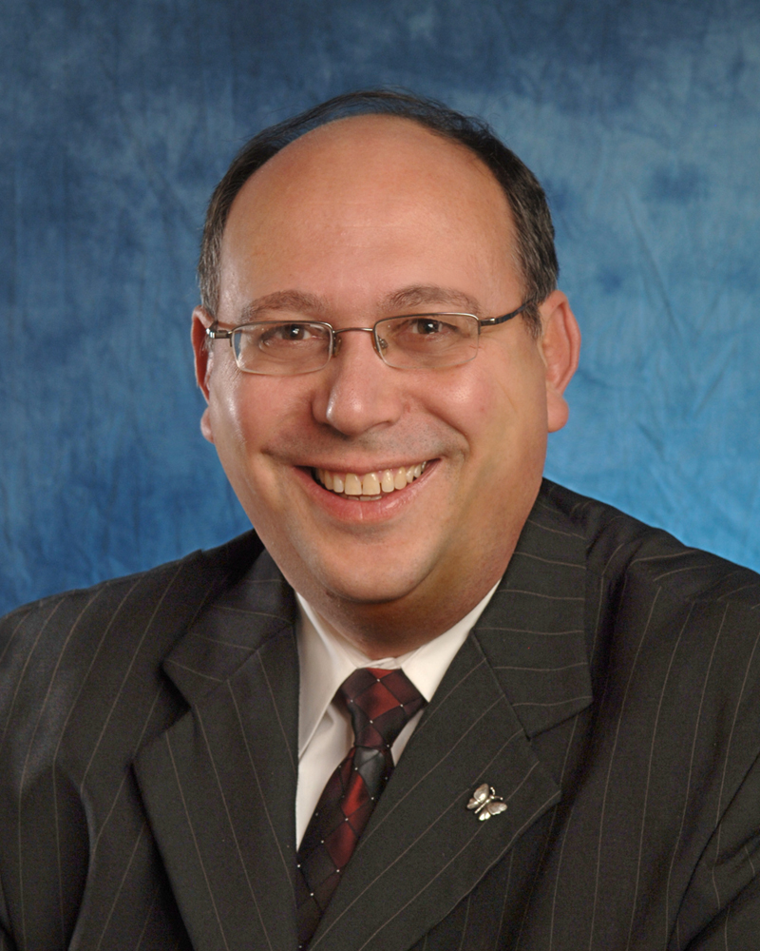
Further Questions about the Program
Contact:
Dr. David R. Penepent, Program Director
585-356-4929 (Cell Number) Between 8AM & 8PM Monday – Friday
315-386-7170 (Office Number)
Email: penepentd@canton.edu

