Slide 1
NYS Payroll Online Self Service
November 2016

Slide 2
Section titles are always placed on the right and right justified, at the same height as content titles.
NYS Payroll Online Phases
Options for Self Service:
Update Pay Statement Option
View W-2
View Direct Deposit Account(s)
Update Tax Withholding
View Paycheck
Update Email Address(es)
SUNY logo endorsement always stays visible in front of all content, unless the SUNY logo is prominently featured somewhere else on the slide.

Slide 3
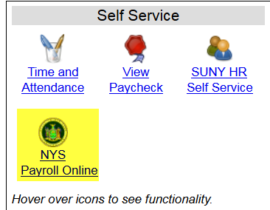
Section titles are always placed on the right and right justified, at the same height as content titles.
LOG IN TO NYS PAYROLL ONLINE
Go to: www.suny.edu/hrportal
Click on the “NYS Payroll Online” icon
SUNY logo endorsement always stays visible in front of all content, unless the SUNY logo is prominently featured somewhere else on the slide.

Slide 4
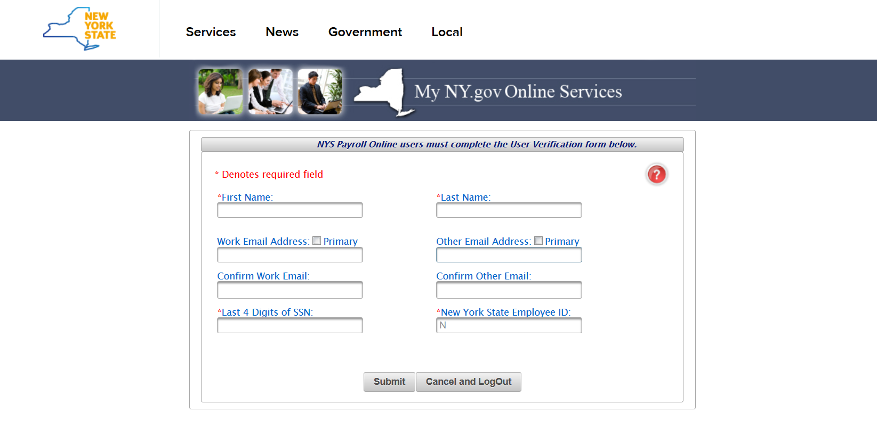
Section titles are always placed on the right and right justified, at the same height as content titles.
LOG IN TO NYS PAYROLL ONLINE
Complete the verification processes the first time you log in. Required fields:
First/Last Name
One Primary Email Address
Last 4 digits of SSN
New York State Employee ID - your nine-digit NYS Employee ID is found on your pay statement.
SUNY logo endorsement always stays visible in front of all content, unless the SUNY logo is prominently featured somewhere else on the slide.

Slide 5
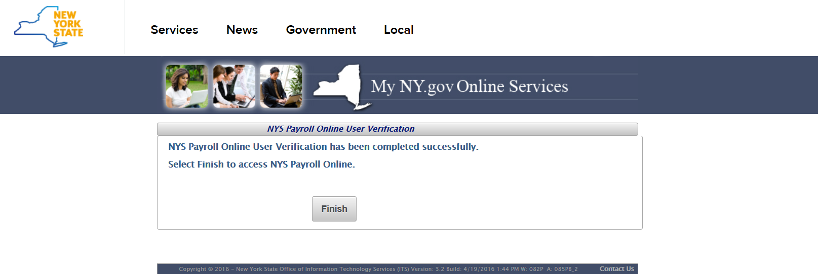
Section titles are always placed on the right and right justified, at the same height as content titles.
NYS Payroll Online Verification
Once you have completed the one time verification process, you will receive this confirmation. Please click “Finish” to continue to the NYS Payroll Online Home Page.
SUNY logo endorsement always stays visible in front of all content, unless the SUNY logo is prominently featured somewhere else on the slide.

Slide 6
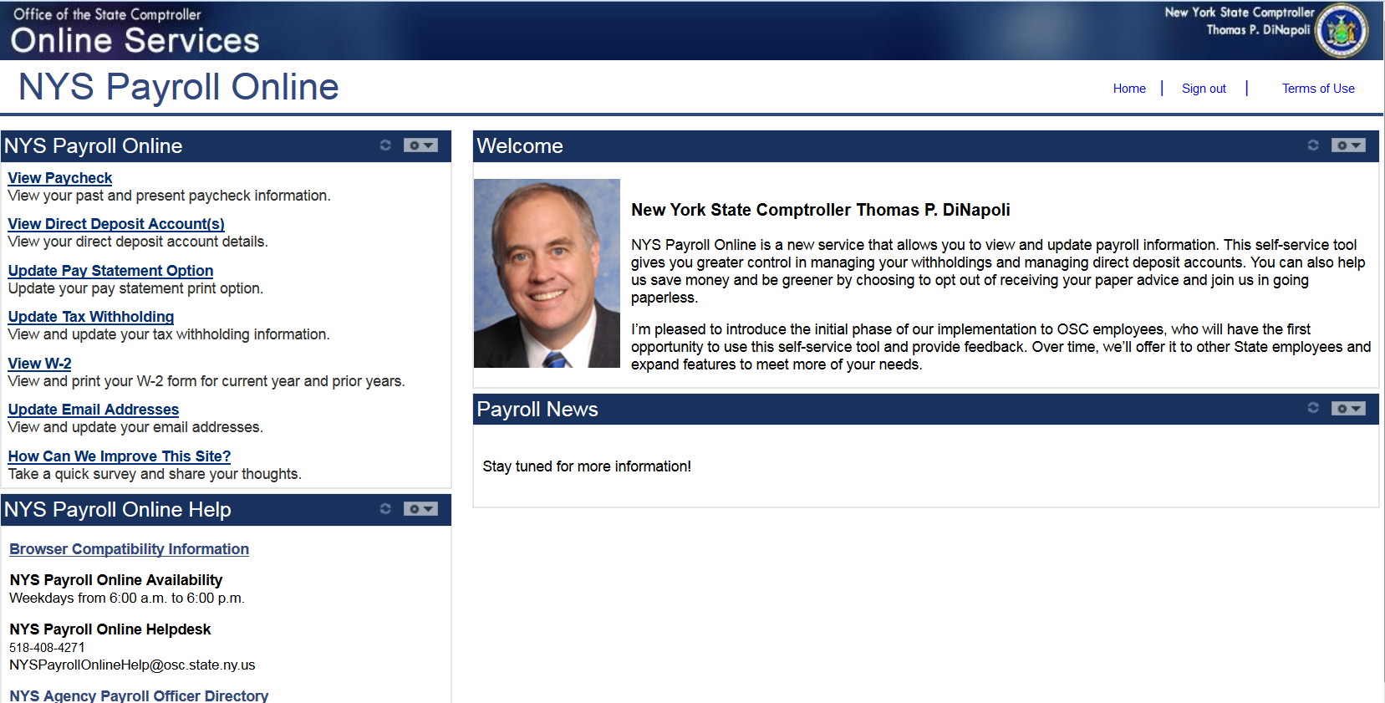
Section titles are always placed on the right and right justified, at the same height as content titles.
NYS Payroll Online Home Page
SUNY logo endorsement always stays visible in front of all content, unless the SUNY logo is prominently featured somewhere else on the slide.

Slide 7
Section titles are always placed on the right and right justified, at the same height as content titles.
Updating Pay Statement Option
Select Update Pay Statement Option from the left menu.
If you work for more than one State agency, then select the Job Title on the Select Job Title page to open the Pay Statement Print Option page.
If you want to go paperless for all of your agencies you will need to complete the process below for EACH Job Title listed.
SUNY logo endorsement always stays visible in front of all content, unless the SUNY logo is prominently featured somewhere else on the slide.

Slide 8
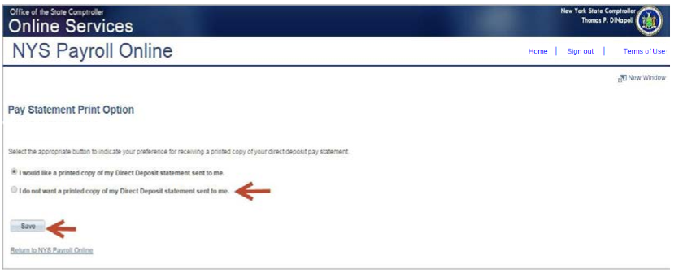
Section titles are always placed on the right and right justified, at the same height as content titles.
Updating Pay Statement (continued)
If you are enrolled in direct deposit, you will see the Pay Statement Print Option page. Select the radio button to indicate “I do not want a printed copy of my Direct Deposit statement sent to me.”
Click Save
SUNY logo endorsement always stays visible in front of all content, unless the SUNY logo is prominently featured somewhere else on the slide.

Slide 9
Section titles are always placed on the right and right justified, at the same height as content titles.
Pay Statement (continued)
An email will be sent to all email addresses stored in NYS Payroll Online when you make a change to your information along with the confirmation pop up shown below.
Click OK to return to the Pay Statement Print Option page.
NOTE: Due to timing, your change may not be reflected in your next paycheck. This is because the change may have been made too late for the payroll system to stop the printing of your most recent direct deposit pay statement. If this is the case, the change will take effect in an upcoming paycheck.
SUNY logo endorsement always stays visible in front of all content, unless the SUNY logo is prominently featured somewhere else on the slide.

Slide 10
Section titles are always placed on the right and right justified, at the same height as content titles.
View, Print and Save W2
NYS Payroll Online makes it easy to view and print your W-2 form for the current year and prior years. You will need Adobe Reader to view your W-2 in NYS Payroll Online.
Select View W-2 from the left menu.
SUNY logo endorsement always stays visible in front of all content, unless the SUNY logo is prominently featured somewhere else on the slide.

Slide 11
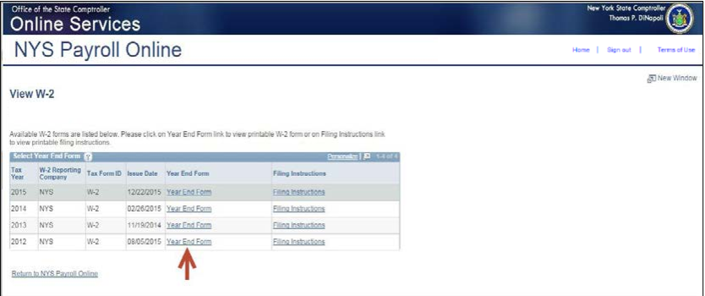
Section titles are always placed on the right and right justified, at the same height as content titles.
View W-2
The View W-2page displays the following items for each W-2 listed:
Tax Year
W-2 Reporting Company
Tax Form ID
Issue Date
Year End Form
Filing Instructions
Click Year End Form to view the W-2 for the selected year. Your W-2 will open as a PDF document in a new browser window.
NOTES:
Please note that the View W-2 page currently shows only W-2 forms. Any amended W-2c forms (corrected W-2s) issued after the W-2 will not be included in this list.
If you are using Internet Explorer, a new browser window will open and ask you if you want to Open or Save your pay statement. Click Open and it will open as an Adobe PDF document in a separate window.
Close the Adobe PDF window when finished viewing your W-2. Your W-2 will remain open until you close this window, even if you log out or are timed out of NYS Payroll Online.
SUNY logo endorsement always stays visible in front of all content, unless the SUNY logo is prominently featured somewhere else on the slide.

Slide 12
Section titles are always placed on the right and right justified, at the same height as content titles.
Print W-2
Print Your W-2 in Internet Explorer
Click File > Print and follow the prompts,
Move the mouse to the bottom of the window , select the Printer icon from the pop-up tool bar, and follow the prompts.
Print Your W-2 in Google Chrome
Click Menu > Print and follow the prompts
Select the Printer icon from the tool bar at the top of the window and follow the prompts.
SUNY logo endorsement always stays visible in front of all content, unless the SUNY logo is prominently featured somewhere else on the slide.

Slide 13
Section titles are always placed on the right and right justified, at the same height as content titles.
Save W-2
Save Your W-2 in Internet Explorer
There are two available options:
Click File > Print and follow the prompts
Move the mouse to the bottom of the window, select the Diskette
icon from the pop-up tool bar, and follow the prompts.
Save Your W-2 in Google Chrome
There are two available options.
Right click, select Save as...and follow the prompts
Select the Download icon from the tool bar at the top of the window and follow the prompts.
SUNY logo endorsement always stays visible in front of all content, unless the SUNY logo is prominently featured somewhere else on the slide.

Slide 14
Section titles are always placed on the right and right justified, at the same height as content titles.
View Direct Deposit Account(s)
Select View Direct Deposit Account(s) from the left hand side menu.
SUNY logo endorsement always stays visible in front of all content, unless the SUNY logo is prominently featured somewhere else on the slide.

Slide 15
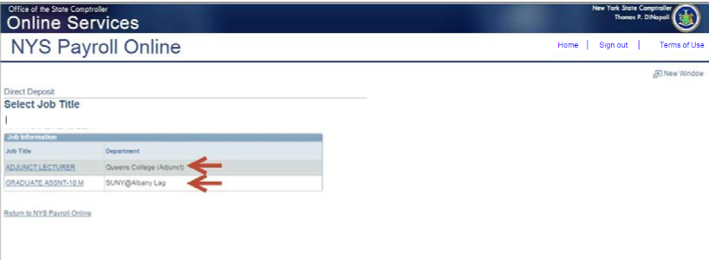
Section titles are always placed on the right and right justified, at the same height as content titles.
Direct Deposit (continued)
If you work in more than one State agency, you will be asked to select which agency you would like to view the direct deposit information for, then select the Job Title on the Select Job Title page to open the Direct Deposit page.
SUNY logo endorsement always stays visible in front of all content, unless the SUNY logo is prominently featured somewhere else on the slide.

Slide 16
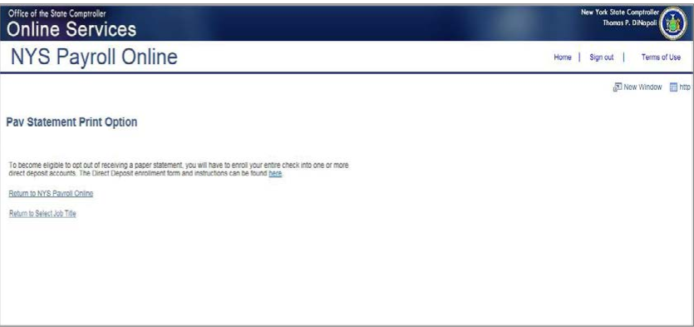
Section titles are always placed on the right and right justified, at the same height as content titles.
Direct Deposit (continued)
If you are not currently enrolled in direct deposit and have no banking information on file, you will receive the message below instead of seeing the Direct Deposit page.
Included on this page is a link to download the direct deposit form. If you want to participate in direct deposit, complete this form and bring it to your payroll office to set up direct deposit for your paychecks.
SUNY logo endorsement always stays visible in front of all content, unless the SUNY logo is prominently featured somewhere else on the slide.

Slide 17
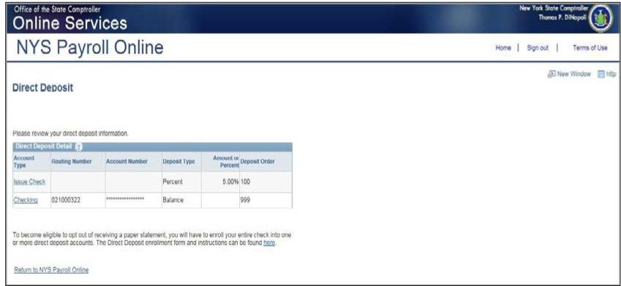
Section titles are always placed on the right and right justified, at the same height as content titles.
Direct Deposit (continued)
If you are enrolled in direct deposit, you can see detailed information about all of your current direct deposit accounts on the Direct Deposit page.
SUNY logo endorsement always stays visible in front of all content, unless the SUNY logo is prominently featured somewhere else on the slide.

Slide 18
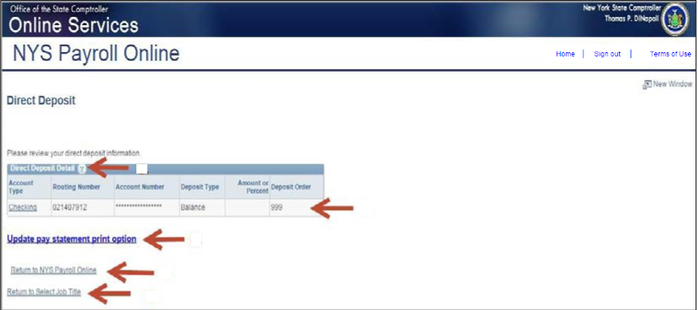
Section titles are always placed on the right and right justified, at the same height as content titles.
Direct Deposit (continued)
Deposit Order indicates the priority that your net pay will be deposited into multiple accounts. Deposit Order allows only values in increments of 100 with an end value of 999.
Example:
Deposit Order 100 = First Account Processed
Deposit Order 999 = Last Account Processed
Click on the ? icon to view additional information about the Direct Deposit page.
Click Return to NYS Payroll Online to return to the NYS Payroll Online Homepage.
Click Return to Select Job Title to select a different Job Title on the Select Job Title page.
Click Update Pay Statement Print Option to update your preference to go paperless and opt out of receiving a printed copy of your direct deposit pay statement. Further information about going paperless and opting out of receiving a printed copy of your direct deposit pay statement, can be found in the NYS Payroll Online Update Pay Statement Option job aid.
SUNY logo endorsement always stays visible in front of all content, unless the SUNY logo is prominently featured somewhere else on the slide.

Slide 19
Section titles are always placed on the right and right justified, at the same height as content titles.
Updating Tax Withholding (continued)
Select Update Tax Withholding from the left menu.
SUNY logo endorsement always stays visible in front of all content, unless the SUNY logo is prominently featured somewhere else on the slide.

Slide 20
Section titles are always placed on the right and right justified, at the same height as content titles.
Updating Tax Withholdings
One of the most exciting features of NYS Payroll Online is that you now have the ability to review and maintain your own tax withholding information. New employees must still complete the paper W-4 (federal) and IT-2104 (NYS) tax withholding forms when they first become employed by New York State but all future changes can be done in NYS Payroll Online. Current NYS employees can begin using NYS Payroll Online immediately to complete their New York State tax withholding changes.
NOTE: The system will only allow you to make changes to your tax withholding information once per day. Be sure to double check any changes before saving them in the system. If you enter inaccurate information you will not be able to correct it using NYS Payroll Online until the next business day. However, your payroll office does not have to wait and can update it for you in the payroll system the same day.
.
SUNY logo endorsement always stays visible in front of all content, unless the SUNY logo is prominently featured somewhere else on the slide.

Slide 21
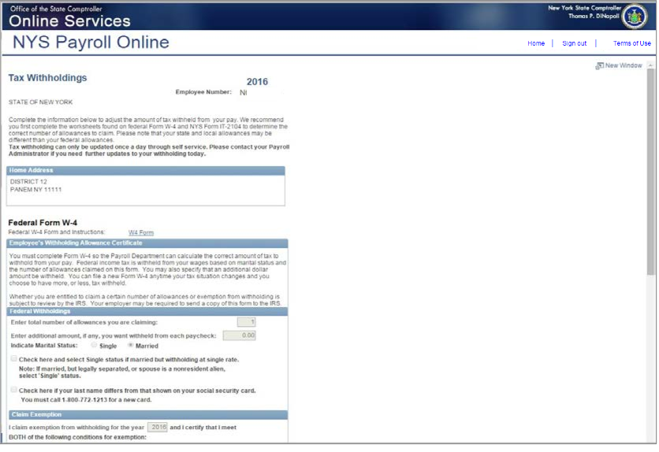
Section titles are always placed on the right and right justified, at the same height as content titles.
Updating Tax Withholding (continued)
From this page you can modify your federal, State, and local tax withholding information.
SUNY logo endorsement always stays visible in front of all content, unless the SUNY logo is prominently featured somewhere else on the slide.

Slide 22
Section titles are always placed on the right and right justified, at the same height as content titles.
Updating Tax Withholding (continued)
Update Your Federal Withholding Change any applicable information.
Enter a new number of total Allowances
Enter an Additional Amount to be withheld.
Change your Marital Status
Check this box if married but withholding at a single rate. You must also indicate Single as your Marital Status
Check this box if your last name does not match the last name on your Social Security card. You must call 1-800-772-1213 for a new card.
SUNY logo endorsement always stays visible in front of all content, unless the SUNY logo is prominently featured somewhere else on the slide.

Slide 23
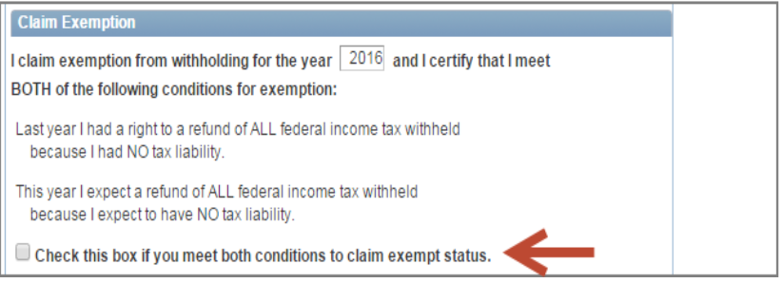
Section titles are always placed on the right and right justified, at the same height as content titles.
Updating Tax Withholding (continued)
Claim an Exemption from Federal Withholding
To claim exemption, you must meet the following conditions:
Last year you had a right to a refund of ALL federal income tax withheld because you had NO tax liability, and
This year you expect a refund of ALL federal income tax withheld because you expect to have NO tax liability.
Check this check box to affirm that you meet both conditions and want to claim exempt status.
SUNY logo endorsement always stays visible in front of all content, unless the SUNY logo is prominently featured somewhere else on the slide.

Slide 24
Section titles are always placed on the right and right justified, at the same height as content titles.
Updating Tax Withholding (continued)
Update Your New York State Tax Withholding
Change any applicable information
Change your Marital Status
Enter total number of State Allowances you want to claim.
Enter an Additional State Amount to be withheld.
NOTE: You cannot claim exemption from NYS tax withholding using NYS Payroll Online. To claim this exemption you must file Form IT-2104-E.
SUNY logo endorsement always stays visible in front of all content, unless the SUNY logo is prominently featured somewhere else on the slide.

Slide 25
Section titles are always placed on the right and right justified, at the same height as content titles.
Updating Tax Withholding (continued)
Update Your Local Tax Withholding
Change any applicable information:
Indicate if you are a resident of New York City
Indicate if you are a resident of Yonkers
Enter total number of Local Allowances you want to claim.
Enter an Additional Local Amount to be withheld.
SUNY logo endorsement always stays visible in front of all content, unless the SUNY logo is prominently featured somewhere else on the slide.

Slide 26
Section titles are always placed on the right and right justified, at the same height as content titles.
Updating Tax Withholding (continued)
Save All Changes
Click Save at the bottom of the page to save all changes to your tax information.
NOTE: Penalty notification for false statements can be found above the Save button.
Click OK to return to the Tax Withholdings page.
NOTE: Due to timing, your changes may not be reflected in your next paycheck
SUNY logo endorsement always stays visible in front of all content, unless the SUNY logo is prominently featured somewhere else on the slide.

Slide 27
Section titles are always placed on the right and right justified, at the same height as content titles.
Updating Tax Withholding (continued)
NOTE: After returning to the Tax Withholdings page you will notice that the Save button has been grayed out. This is because you can only make changes to your tax withholding information once per day.
If you return to the Tax Withholdings page AFTER tax withholdings are modified and saved, you will immediately receive a message informing you that it can only be updated once per day.
SUNY logo endorsement always stays visible in front of all content, unless the SUNY logo is prominently featured somewhere else on the slide.

Slide 28
Section titles are always placed on the right and right justified, at the same height as content titles.
Updating Tax Withholding (continued)
Other Information on the Tax Withholdings Page
Link to the federal W-4 form and instructions.
Link to the NY State IT-2104 form and instructions.
Once changes are completed, Click Return to NYS Payroll Online to return to the NYS Payroll Online Home page.
SUNY logo endorsement always stays visible in front of all content, unless the SUNY logo is prominently featured somewhere else on the slide.

Slide 29
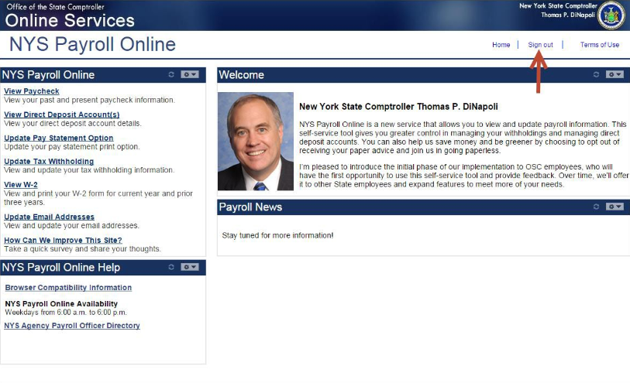
Section titles are always placed on the right and right justified, at the same height as content titles.
Sign Out
Sign Out
For security purposes, you should always Sign out of NYS Payroll Online when you are finished viewing or updating your payroll information and close any other open browser windows.
SUNY logo endorsement always stays visible in front of all content, unless the SUNY logo is prominently featured somewhere else on the slide.

Slide 30
Section titles are always placed on the right and right justified, at the same height as content titles.
Questions (?)
Please contact the Payroll Office at 315-386-7012 or payroll@canton.edu with any questions.
Thank you!
SUNY logo endorsement always stays visible in front of all content, unless the SUNY logo is prominently featured somewhere else on the slide.

