Slide 1
Square Peg, Round Hole
How to fit you into the institutional scorecard
February 2013

Slide 2
Purpose
The institutional scorecard is the “closing the loop” document to show the linkage between planning, assessment, and budget
Helps us in mapping institutional and departmental priorities and shows quantifiable progress toward achieving our goals

Slide 3
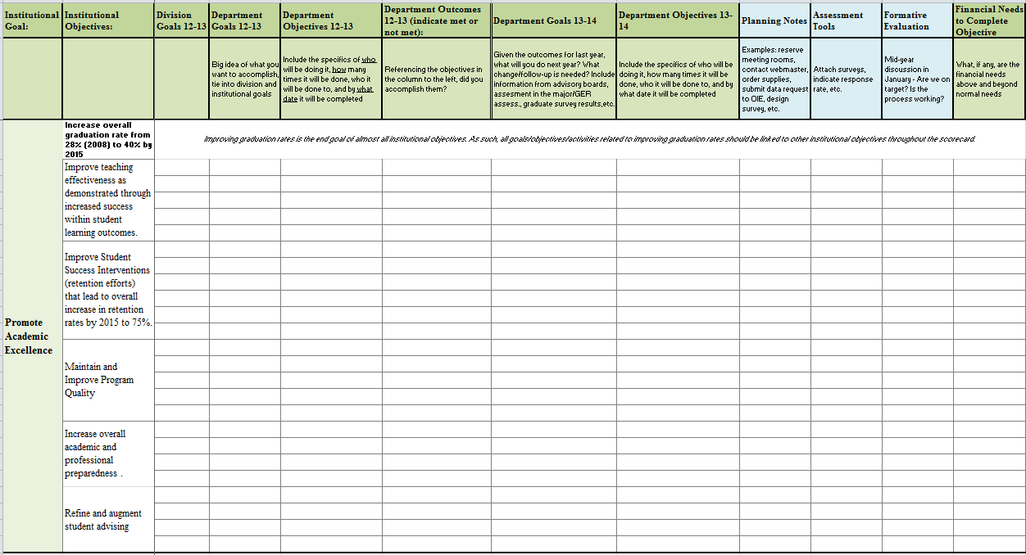

Slide 4
Components
Goals: broad, general statements of the big plan to be worked on
Objectives: specific, quantifiable statements including the who, what, when, where, why, and how often
Outcomes: for last year’s objectives, to what extent did you accomplish them?

Slide 5
Components, cont.
Goals and Objectives, 13-14: Given your outcomes for 12-13, what are your plans for next year? What changes are you going to make to your goals and objectives?
Planning Notes, Assessment Tools, Formative Evaluation: Optional components (except for student affairs) to assist you in further developing your objectives
Financial Need to Complete Objective: If completion of an objective requires funding, how much is needed?

Slide 6
What to Include
Issues raised by the Student Opinion Survey and other assessments, and the plan for addressing them
Staffing assessments
# of students/faculty/staff/ community members served by the program and future goals
Retention/graduation rates (if applicable) for student groups served.

Slide 7
How to Start
Look at mission/vision statement for department
Look at goals/objectives from previous years
Make a list of everything you are doing and why

Slide 8
For More Information
The Institutional Effectiveness website includes the template, suggested elements for inclusion, the 2011-12 campus institutional scorecard, and past presentations
www.canton.edu/effectiveness

