Slide 1
SUNY Canton Travel Polices & Procedures

Slide 2
Before the Trip
Before any travel for the state of NY:
Apply for a NYS VISA travel card. This reduces the amount of unnecessary out-of-pocket expenses and employee reimbursements.
Complete a T1 (Travel Authorization form) this is an estimate to help determine the cost of your trip.
Travel arrangements should always be made in the best interest of the state.
Learn more at www.canton.edu/travel

Slide 3
Travel Card Application

Slide 4
T1 – Travel Request Form Trip Authorization ●Must be received by the travel office 2 weeks prior to travel ● The form must be fully completed! This includes: name, dates, destination, purpose of trip, all cost estimates ●Check per diem rates for the area you are traveling to: https://www.gsa.gov/travel/plan-book/per-diem-rates ●The form must include account number and all signatures – including VP signature if trip is out of state ●No charges should be made to the travel card until the T1 has all signature approvals ●If charges are made to the card, prior to receiving the proper approvals you could be personally responsible for those charges

Slide 5
When completing your T1, consider:
What mode of transportation will you take?
State Car –
Must be LENS approved
Only NYS employees are able to ride in the Fleet vehicles
Rental –
Use a Contract Vendor – (Enterprise or Hertz) and make sure you’re getting contract pricing!
Make sure you are charging the rental to your travel card, and not direct billing SUNY Canton
Do NOT purchase additional insurance when using the travel card
Airfare -
We use the services of Child Travel NY (also known as Direct Travel or Concur)
You should not be using any .com’s to book airfare unless you can save >$200
Airfare can only be put on a travel card. You can not be personally
reimbursed for airfare!

Slide 6
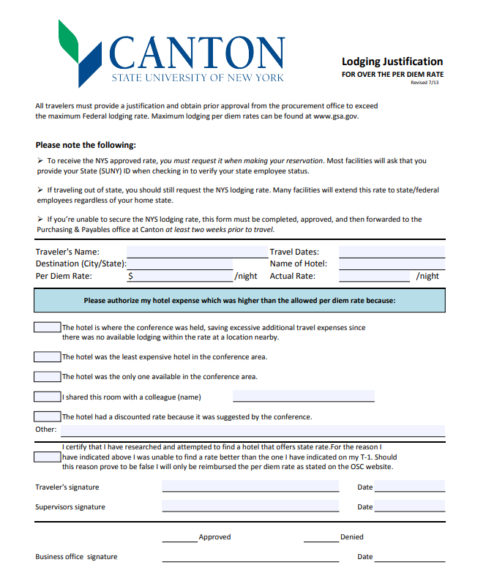
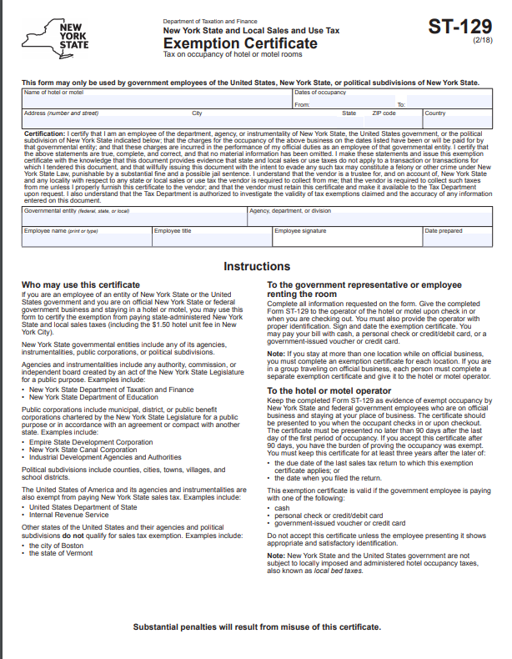
Where will you be lodging?
Be sure to get Tax Exempt and the State Rate when booking lodging! It is best to call the hotel directly, because most .com’s will charge you tax, and it is difficult to get that tax removed.
If you can not find the state rate when booking your reservation, you must complete an over-the max justification form and get approval PRIOR to the trip.
We are also TAX EXEMPT in the following states: California, Florida, Maine, Missouri, New Jersey, North Dakota, and Rhode Island.
Tax Exempt Form
Over-the-max Justification Form

Slide 7
Registration Fees:
1. If an in person conference, registration and conference fees should be paid via Travel Card when possible (First Preference) Virtual conferences can not be paid with a travel card because you are not travelling to attend!
2. Can be paid via check, but we need to have 2 weeks processing time and the following information:
Payee Name
Federal ID
Address
A copy of your registration form
3. Could also be paid via Purchasing card
4. Can be paid personally and get reimbursed after the trip (last resort)

Slide 8
Charges that can be put on a Travel Card:
Registration/Conference Fees Lodging
Airfare
Train/Bus
Rental Vehicle
Fuel for rental or state car only
Meals
Parking
Baggage
Tolls
Taxi/Uber
ONLY YOUR OWN EXPENSES
ON YOUR OWN CARD!

Slide 9
Charges that can NOT be put on a travel card:
Virtual conferences
Alcohol
Expenses for another traveler, even if they are another SUNY Canton traveler
Any Entertainment of any kind
Cash Advances can not be taken out on the card
Fuel for your personal vehicle
Personal charges
Improper or unauthorized charges may result in mandated reimbursement to the agency by the employee, suspension, loss of privileges related to the card, or disciplinary action

Slide 10
Travel Voucher Travel Reconciliation
Reimbursement of travel expenses MUST be submitted to the Travel Coordinator within 30 days of your departure date.
All expenses MUST be recorded and receipts attached to a completed travel voucher.
The travel voucher MUST be signed by the traveler and the Account Manager (whomever is funding the trip.)
There is a two week turnaround time for reimbursements.

Slide 11
If you are claiming personal vehicle mileage you also need to include the following with your travel voucher :
Mileage Worksheet
A copy of your route via Google Maps or mapquest

Slide 12
Amanda Rowley Travel Coordinator Asst. to the VP for Administration
315-386-7559
rowleya@canton.edu
www.canton.edu/travel
This training is just a “brief” overview of some of the various travel policies and procedures.
Once you apply for a NYS Travel card, you will be required to go through a “in depth” training of all travel policies and procedures with the travel coordinator before you are able to make charges to the card.

